Slide 1
Theory of machines Wessam Al Azzawi
Balancing of Rotating Masses
The high speed of engines and other machines is a common phenomenon now-a-days. It is, therefore, very essential that all the rotating and reciprocating parts should be completely balanced as far as possible. If these parts are not properly balanced, the dynamic forces are set up. These forces not only increase the loads on bearings and stresses in the various members, but also produce unpleasant and even dangerous vibrations. In this chapter we shall discuss the balancing of unbalanced forces caused by rotating masses, in order to minimize pressure on the main bearings when an engine is running.
whenever a certain mass is attached to a rotating shaft, it exerts some centrifugal
force, whose effect is to bend the shaft and to produce vibrations in it. In order to prevent the effect of centrifugal force, another mass is attached to the opposite side of the shaft, at such a position so as to balance the effect of the centrifugal force of the first mass. This is done in such a way that the centrifugal force of both the masses are made to be equal and opposite. The process of providing the second mass in order to counteract the effect of the centrifugal force of the first mass, is called balancing of rotating masses.

Slide 2
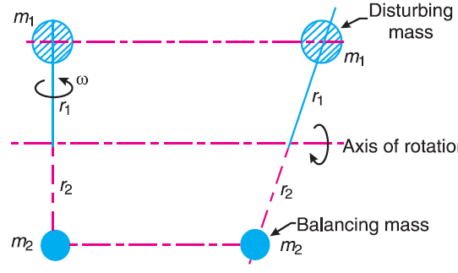
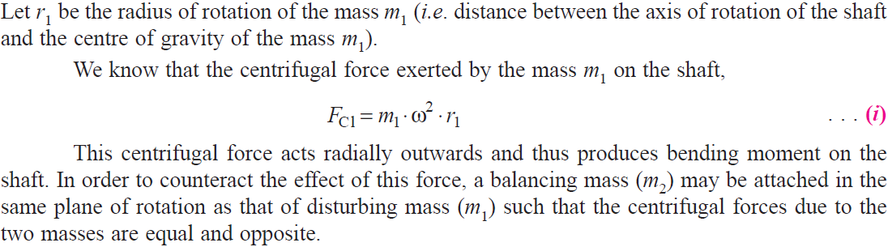
Theory of machines Wessam Al Azzawi
Balancing of Rotating Masses
Balancing of a Single Rotating Mass By a Single Mass Rotating in the Same Plane
Consider a disturbing mass m1 attached to a shaft rotating at ω rad/s as shown in Fig.

Slide 3
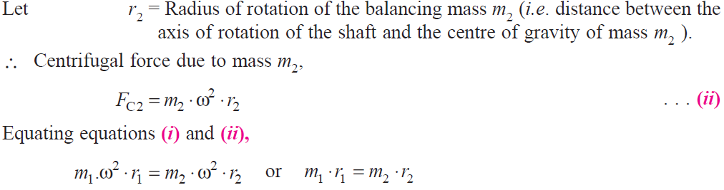
Theory of machines Wessam Al Azzawi

Slide 4
Theory of machines Wessam Al Azzawi
In order to put the system in complete balance, two balancing masses are placed in two different planes, parallel to the plane of rotation of the disturbing mass, in such a way that they satisfy the following two conditions of equilibrium.
The net dynamic force acting on the shaft is equal to zero. This requires that the line of action of three centrifugal forces must be the same. In other words, the centre of the masses of the system must lie on the axis of rotation. This is the condition for static balancing.
The net couple due to the dynamic forces acting on the shaft is equal to zero. In other words, the algebraic sum of the moments about any point in the plane must be zero.
The conditions (1) and (2) together give dynamic balancing. The following two possibilities may arise while attaching the two balancing masses :
The plane of the disturbing mass may be in between the planes of the two balancing masses, and
The plane of the disturbing mass may lie on the left or right of the two planes containing the balancing masses.

Slide 5
Theory of machines Wessam Al Azzawi
When the plane of the disturbing mass is between the planes of the two balancing masses
Consider a disturbing mass m lying in a plane A to be balanced by two rotating masses m₁ and m₂ lying in two different planes L and M as shown in Fig.a. Let r, r₁ and r₂ be the radii of rotation of the masses in planes A, L and M respectively.
a

Slide 6
Theory of machines Wessam Al Azzawi
a

Slide 7
Theory of machines Wessam Al Azzawi
a

Slide 8
Theory of machines Wessam Al Azzawi
When the plane of the disturbing mass lies on one end of the planes of the balancing masses
In this case, the mass m lies in the plane A and the balancing masses lie in the planes L and M, as shown in Fig.b. As discussed above, the following conditions must be satisfied in order to balance the system, i.e.
b

Slide 9
Theory of machines Wessam Al Azzawi
b

Slide 10
Theory of machines Wessam Al Azzawi
Consider any number of masses (say four) of magnitude m₁, m₂, m₃ and m₄ at distances of
r₁, r₂, r₃ and r₄ from the axis of the rotating shaft. Let θ₁, θ₂,θ₃ and θ₄ be the angles of these
masses with the horizontal line OX, as shown in Fig. (a). Let these masses rotate about an axis through O and perpendicular to the plane of paper, with a constant angular velocity of ω rad/s.
Balancing of Several Masses Rotating in the Same Plane

Slide 11
Theory of machines Wessam Al Azzawi
First of all, find out the centrifugal force (or the product of the mass and its radius of rotation) exerted by each mass on the rotating shaft.
Resolve the centrifugal forces horizontally and vertically and find their sums, i.e. ΣH and ΣV:
Magnitude of the resultant centrifugal force,
If θ is the angle, which the resultant force makes with the horizontal, then
The balancing force is then equal to the resultant force, but in opposite direction.
Now find out the magnitude of the balancing mass, such that
Analytical, the magnitude and direction of the balancing mass may be obtained, analytically, as discussed below :

Slide 12
Theory of machines Wessam Al Azzawi

Slide 13
Theory of machines Wessam Al Azzawi
Analytical method

Slide 14
Theory of machines Wessam Al Azzawi
Graphical method
The magnitude and the position of the balancing mass may also be found graphically as discussed below :
First of all, draw the space diagram showing the positions of all the given masses as shown in Fig (a).
2. Since the centrifugal force of each mass is proportional to the product of the mass and radius, therefore

Slide 15
Theory of machines Wessam Al Azzawi
Now draw the vector diagram with the above values, to some suitable scale, as shown in Fig.(b). The closing side of the polygon ae represents the resultant force. By measurement, we find that ae = 23 kg-m.
The balancing force is equal to the resultant force, but opposite in direction. Since the balancing force is proportional to m.r, therefore m × 0.2 = vector ea = 23 kg-m or m = 23/0.2 = 115 kg Ans.
By measurement we also find that the angle of inclination of the balancing mass (m) from the horizontal mass of 200 kg, θ = 201° Ans.

Slide 16
Theory of machines Wessam Al Azzawi
Balancing of Several Masses Rotating in Different Planes
When several masses revolve in different planes, they may be transferred to a reference plane (R.P.), which may be defined as the plane passing through a point on the axis of rotation and perpendicular to it. The effect of transferring a revolving mass to a reference plane is to cause a force of magnitude equal to the centrifugal force of the revolving mass to act in the reference plane, together with a couple of magnitude equal to the product of the force and the distance between the plane of rotation and the reference plane. In order to have a complete balance of the several revolving masses in different planes, the following two conditions must be satisfied :
1. The forces in the reference plane must balance, i.e. the resultant force must be zero.
2. The couples about the reference plane must balance, i.e. the resultant couple must be zero.
Let us now consider four masses m₁, m₂, m₃ and m₄ revolving in planes 1, 2, 3 and 4 respectively as shown in Fig. (a)

Slide 17
Theory of machines Wessam Al Azzawi
The relative angular positions of these masses are shown in the end view Fig. (b).
The magnitude of the balancing masses m_{L} and m_{M} in planes L and M may be obtained as discussed below :
1. Take one of the planes, say L as the reference plane (R.P.). The distances of all the other planes to the left of the reference plane may be regarded as negative, and those to the right as positive.

Slide 18
Theory of machines Wessam Al Azzawi
2. Tabulate the data as shown in Table.1. The planes are tabulated in the same order in which they occur, reading from left to right.

Slide 19
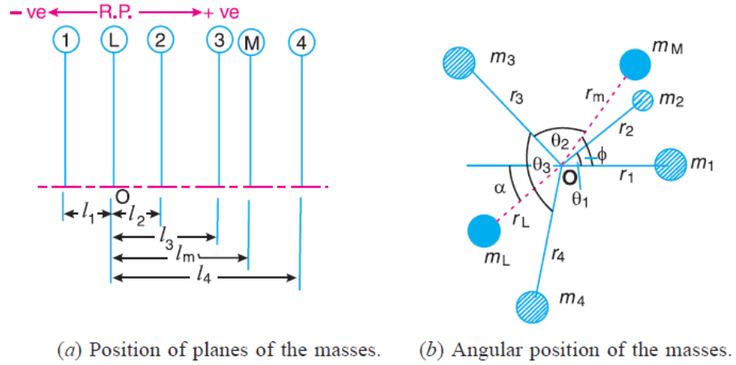
Theory of machines Wessam Al Azzawi
3. A couple may be represented by a vector drawn perpendicular to the plane of the couple. The couple C₁ introduced by transferring m₁ to the reference plane through O is proportional to m₁.r₁.l₁ and acts in a plane through Om₁ and perpendicular to the paper. The vector representing this couple is drawn in the plane of the paper and perpendicular to Om₁ as shown by OC₁ in Fig.c. Similarly, the vectors OC₂, OC₃ and OC₄ are drawn perpendicular to Om₂, Om₃ and Om₄ respectively and in the plane of the paper.

Slide 20
Theory of machines Wessam Al Azzawi
4. Turned vectors counter clockwise through a right angle for convenience as shown in Fig.d. We see that their relative positions remains unaffected. Now the vectors OC₂, OC₃ and OC₄ are parallel and in the same direction as Om₂, Om₃ and Om₄, while the vector OC₁ is parallel to Om₁ but in opposite direction. Hence the couple vectors are drawn radially outwards for the masses on one side of the reference plane and radially inward for the masses on the other side of the reference plane.

Slide 21
Theory of machines Wessam Al Azzawi
5. Now draw the couple polygon as shown in Fig.e.
From this expression, the value of the balancing mass m_{M} in the plane M may be obtained, and the angle of inclination φ of this mass can be measured.

Slide 22
Theory of machines Wessam Al Azzawi
6. Now draw the force polygon as shown in Fig.f. The vector eo (in the direction from e to o ) represents the balanced force. Since the balanced force is proportional to m_{L}.r_{L}, therefore,.
From this expression, the value of the balancing mass m_{L} in the plane L may be obtained and the angle of inclination α of this mass with the horizontal may be measured from Fig. b or f.

Slide 23
Theory of machines Wessam Al Azzawi
The data may be tabulated as shown in Table.2.

Slide 24
Theory of machines Wessam Al Azzawi

Slide 25
Theory of machines Wessam Al Azzawi
The vector d′ o′ represents the balanced couple. Since the balanced couple is proportional to 0.04 m_{Y}, therefore by measurement,
0.04 m_{Y} = vector d′ o′ = 7.3 kg-m2
or m_{Y} = 182.5 kg Ans.

Slide 26
Theory of machines Wessam Al Azzawi
The angular position of the mass m_{Y} is obtained by drawing OmY in Fig.(b), parallel to vector d′ o′ . By measurement, the angular position of m_{Y} is θ_{Y} = 12° in the clockwise direction from mass m_{A} (i.e. 200 kg ). Ans.

Slide 27
Theory of machines Wessam Al Azzawi

